Slide 1

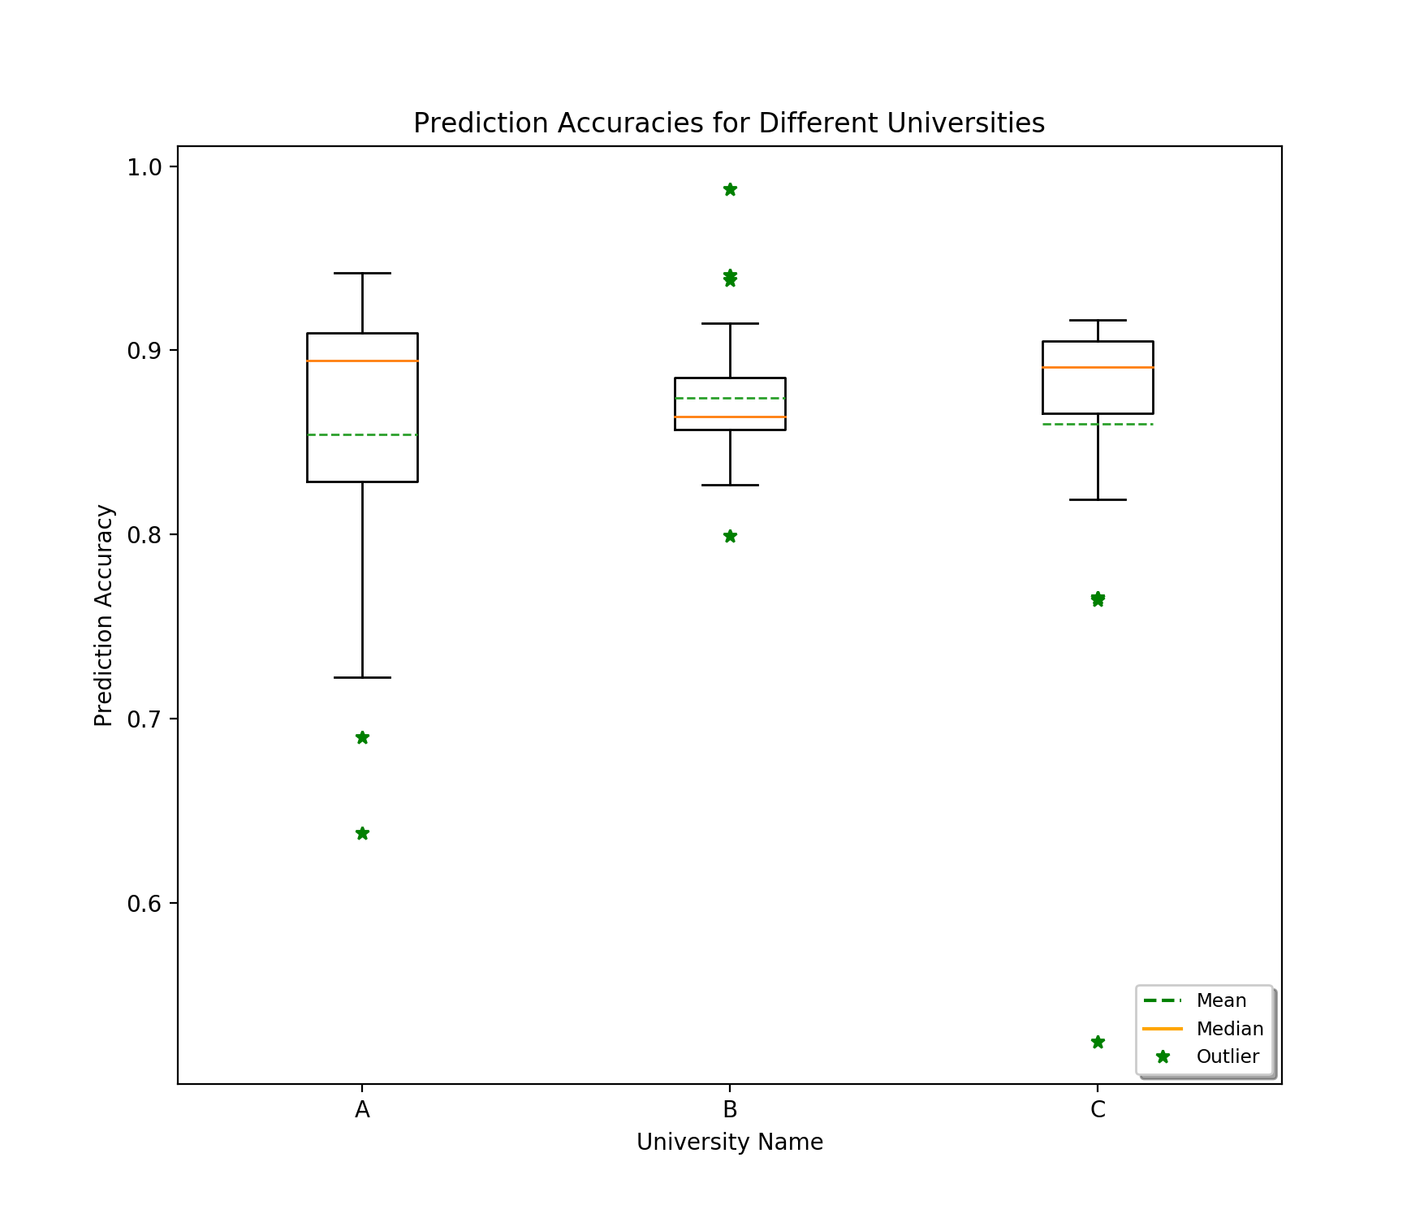
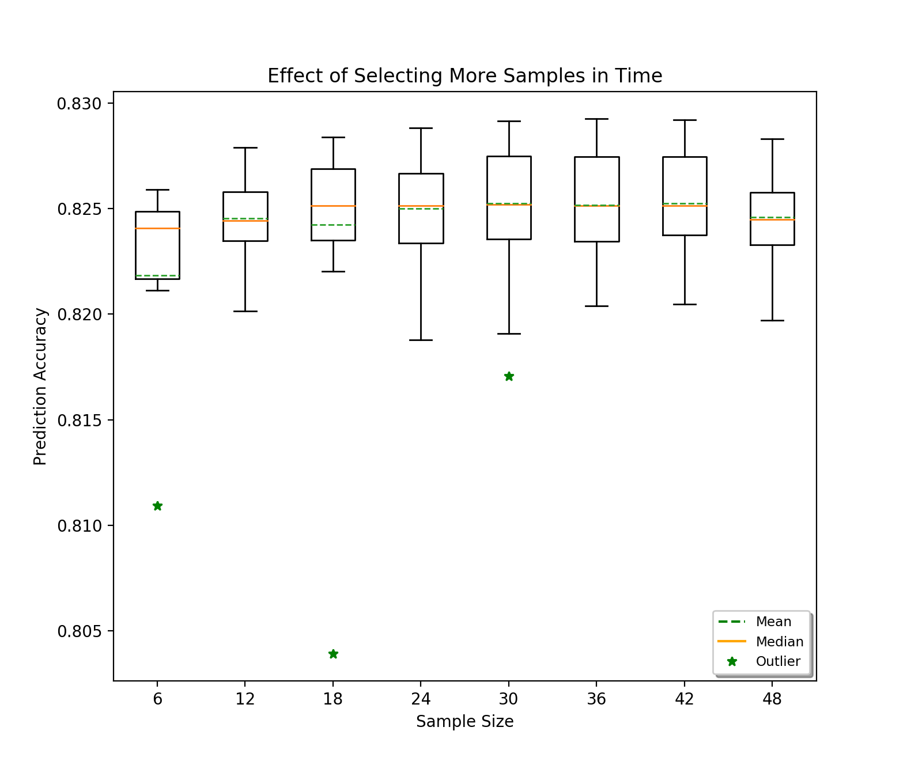

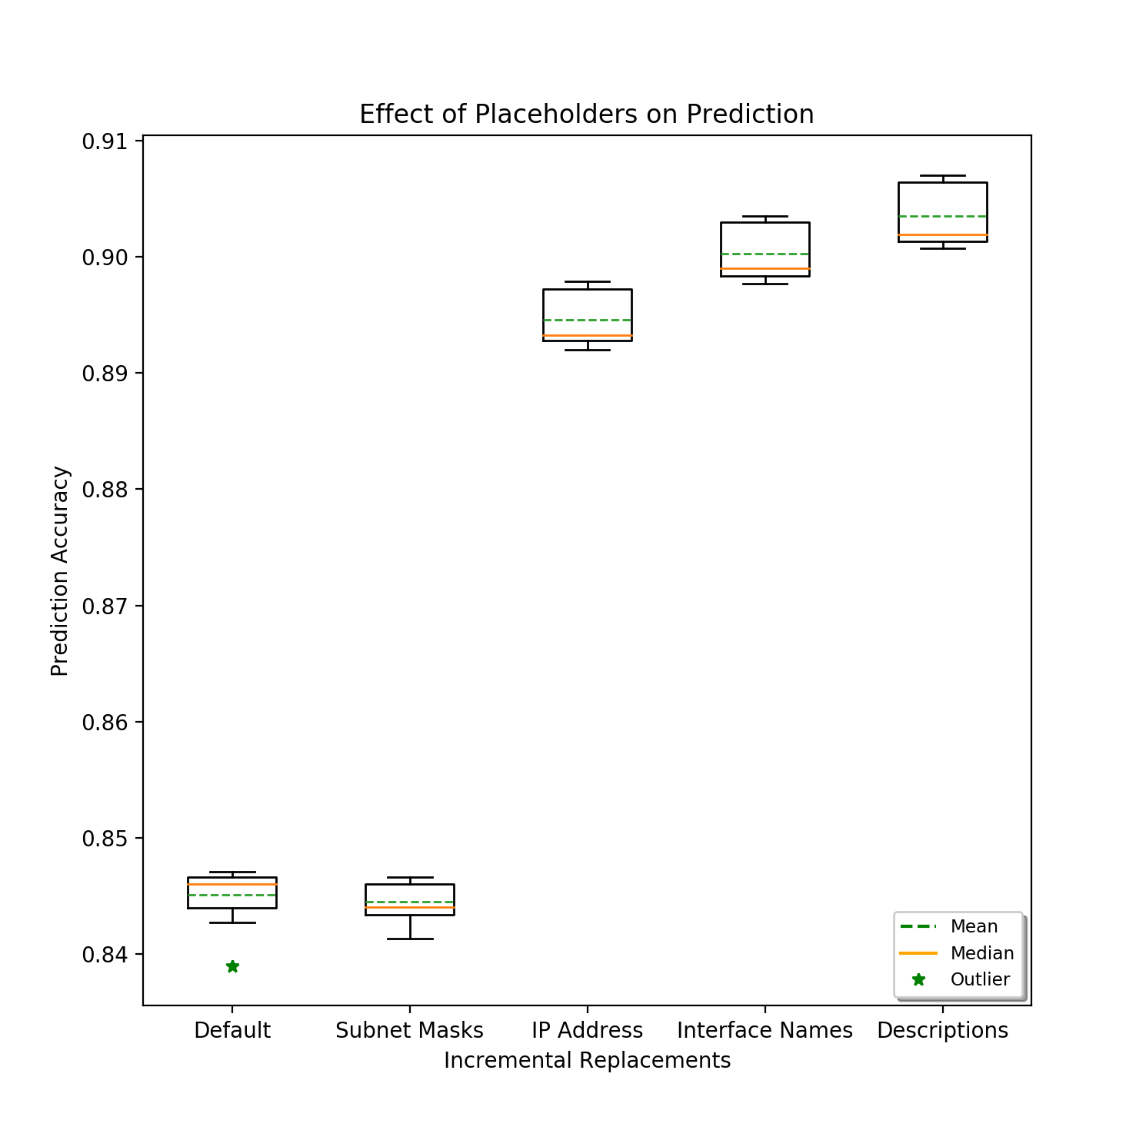
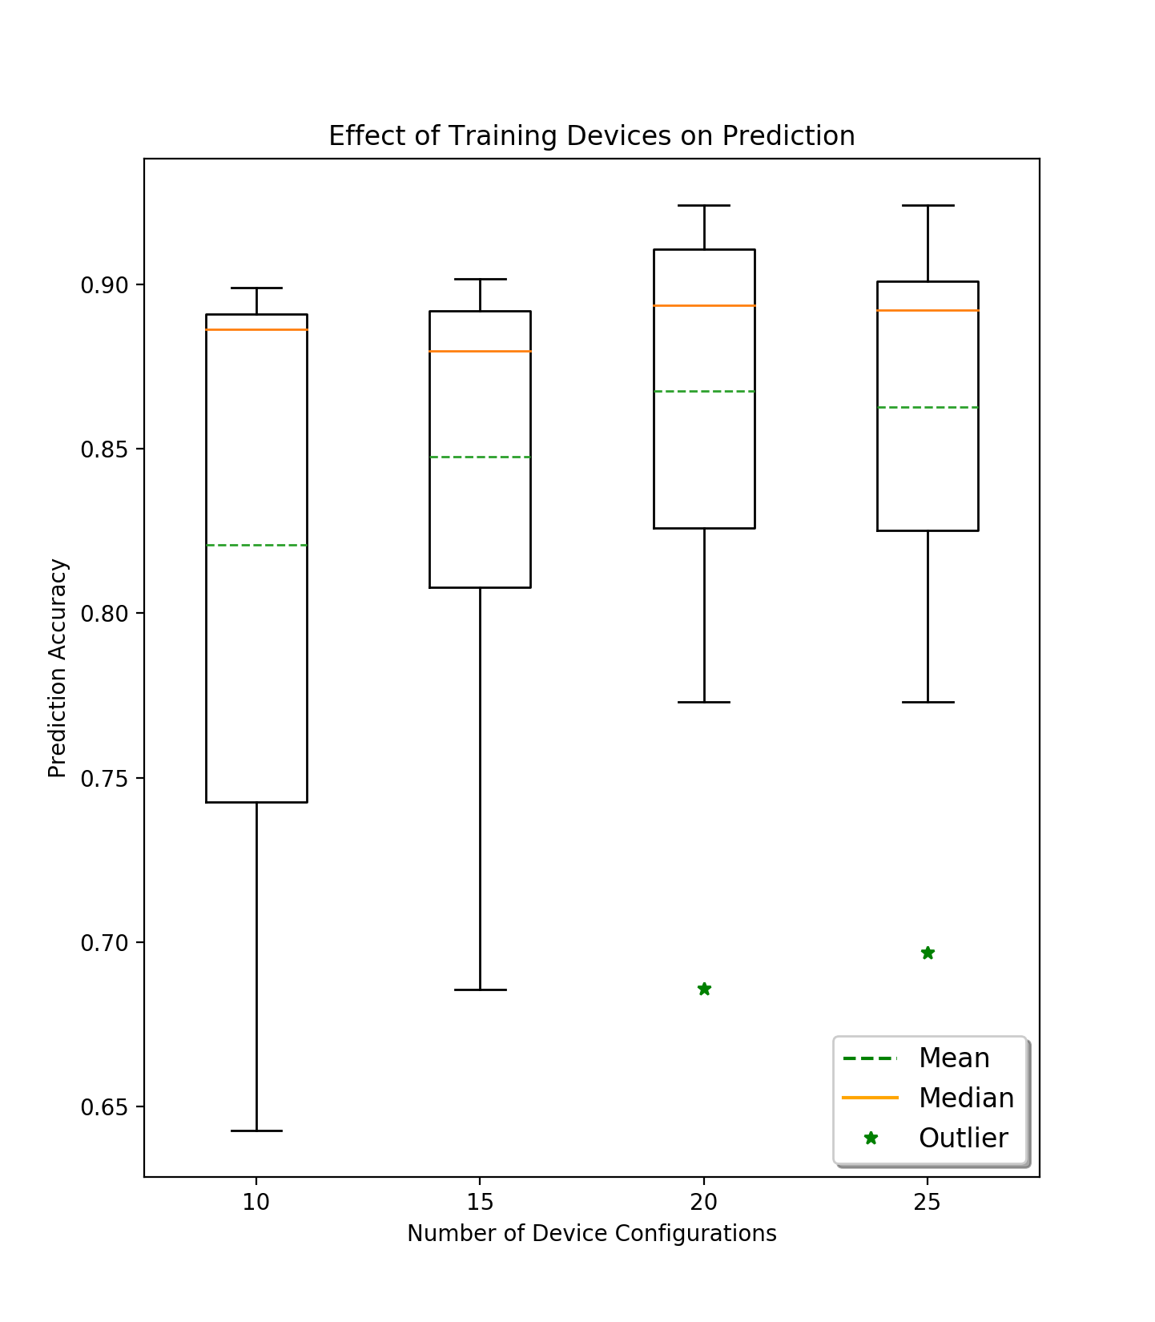
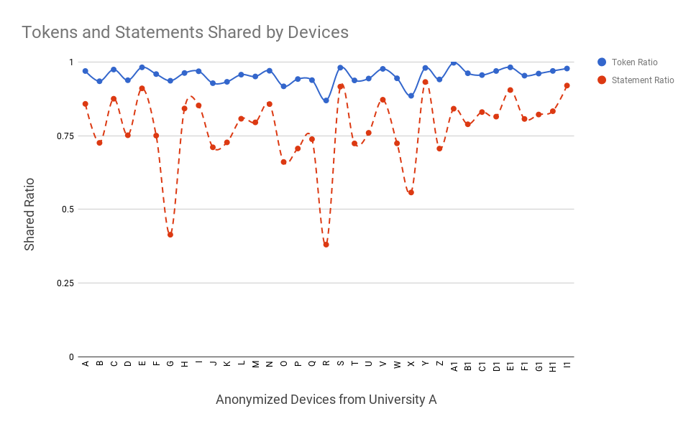
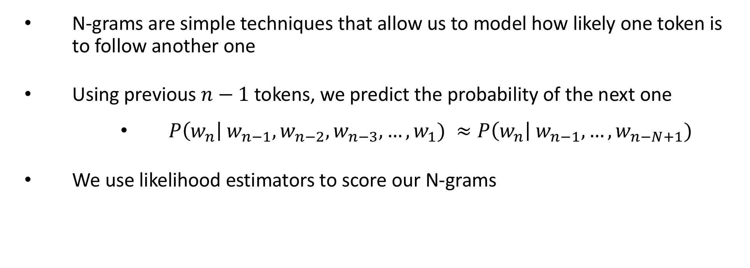
Auto-completion for Network Configurations
Ahsan Mahmood, Aaron Gember-Jacobson
Colgate University
Introduction
N-gram Model
Results
Configurations are often complex, consisting of thousands of lines of low-level directives and dozens of symbolic references
Configuration errors are common and the leading cause of network outages [2]
N-grams are simple techniques that allow us to model how likely one token is to follow another one
Using previous $n−1$ tokens, we predict the probability of the next one
$P\left(w_{n}\right| w_{n−1},w_{n−2},w_{n−3}, …,w_{1}) ≈P\left(w_{n}\right| w_{n−1}, …,w_{n−N+1})$
We use likelihood estimators to score our N-grams
placeholders
State of the art tools offer simple tab-completion and preset templates
We predict a code completion engine would offer better resilience to human errors
We employ a networking- specific optimization predicated by our observation that IP prefixes are often unique to devices
We replace these prefixes and certain other tokens with generic PREFIX tokens
Figure 3: The prediction accuracy for the routers in each network. Our approach achieves a high prediction accuracy (>85%) for the majority of routers. Without our placeholders optimization, this accuracy is 5% lower.
Figure 4: Our framework does not require a long history of configurations to achieve reasonable accuracy.
Feasibility analysis
Previous measurement studies have revealed extensive use of templates in network configurations [1]
Our observations indicate that most of a device’s configuration could be constructed from existing configurations
Our prediction engine thus constructs a model from histories of configurations
Figure 5 (Right): Training on more devices results in higher accuracies. However, training on more devices has diminishing re- turns, because additional devices play the same role as existing devices, and hence are very similar.
Figure 2: With our placeholders optimization, this accuracy is 5% higher.
Testing methodology
We applied our framework to Cisco configurations of core, border, and distribution routers from three large university networks. To test the accuracy of our model, we perform leave-one- out cross validation: one (set of) configuration(s) is used for testing and the remainder are used for training. We “rebuild” the test configuration(s) token-by-token by using our n-gram model to predict the next token based on the prior n-1 tokens; we do not predict across lines. A prediction is marked as successful when the actual next token in the configuration is within the top three results generated by the model.
Future work
Evaluate our model against the current state of the art: tab-completion in CLIs on modern routers
Using larger n-grams to suggest complete statements
Stanza specific models
University | Number of Configurations | Total Lines | Average Lines
A | 35 | 73K | 2.1K
B | 26 | 61K | 2.3K
C | 24 | 67K | 2.8K
references
[1] T. Benson, A. Akella, and D. Maltz. Unraveling the complexity of network management. In NSDI, 2009.
[2] Z. Yin, X. Ma, J. Zheng, Y. Zhou, L. N. Bairavasundaram, and S. Pasupathy. An empirical study on configuration errors in commercial and open source systems. In SOSP, 2011.
Figure 1: Token and statement similarity for University-A. Almost all configurations were composed of the same set of unique tokens.
Table 1: Configurations used in our evaluation

